Slide 1
Online implement -Food waste issues-
Aahana Pant
Miwa Okada
Sajju Maharjan
Sawane Kato
Seika Sato

Slide 3
INTRODUCTION
SNS advocacy
Online
Survey
Facebook
page
Our Implementation

Slide 4
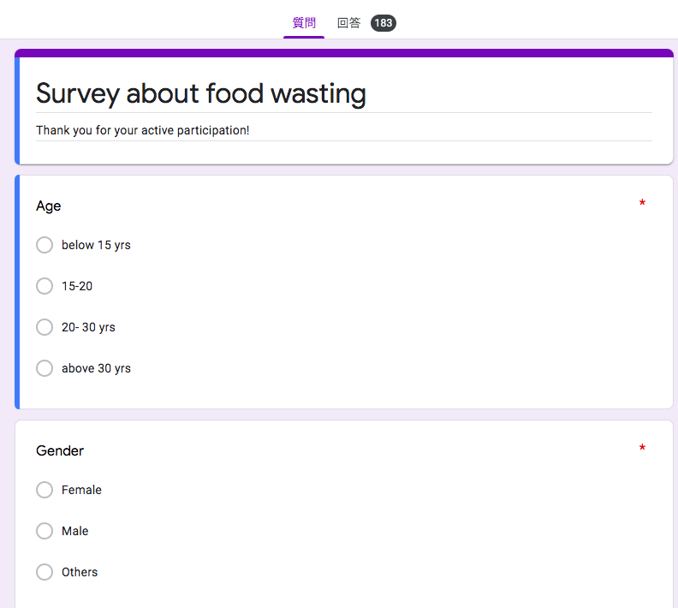
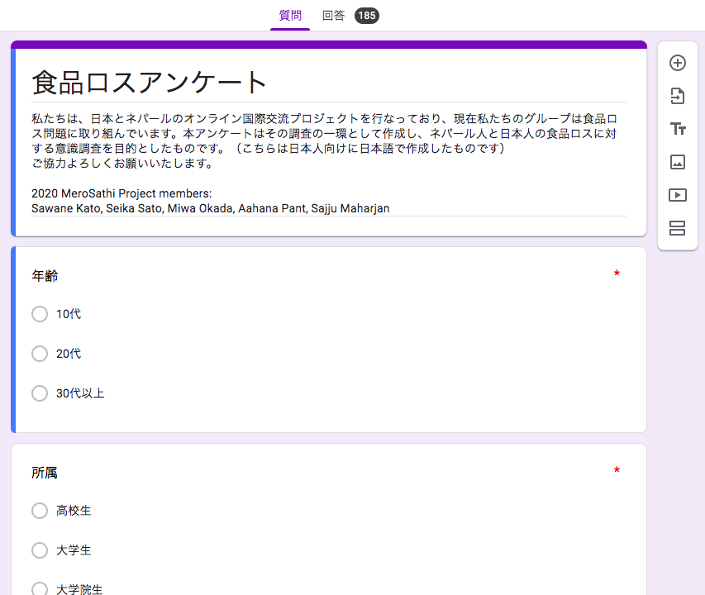
1. ONLINE SURVEY

Slide 5
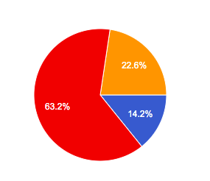
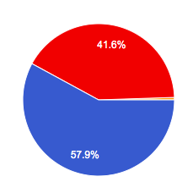
Attribute of respondents [Japan]
Age
●10-19
●20-29
●above 30
Gender
●Female
●Male
●Others
190 responses in total

Slide 6
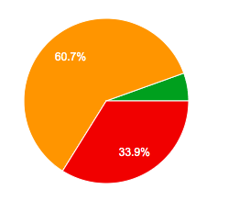
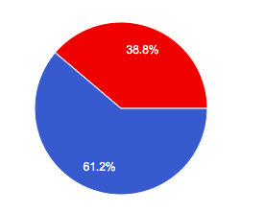
Attribute of respondents [Nepal]
Age
●10-19
●20-29
●above 30
Gender
●Female
●Male
●Others
183 responses in total

Slide 7
How much do you know about the issue of food waste?
Have you ever wasted or witnessed any wastage of food?
If yes, where?
Suggestion to minimize food waste?
Have you ever done any of those in daily life?

Slide 8
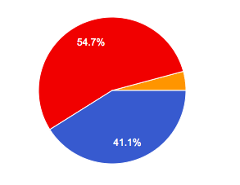
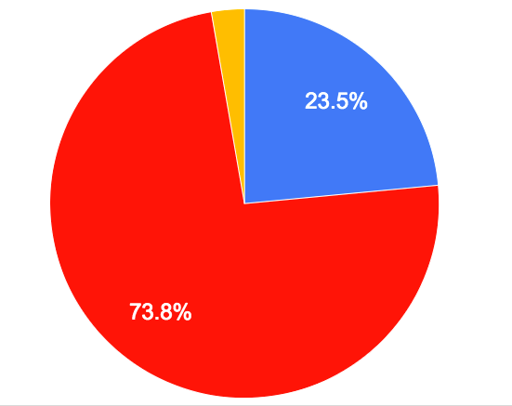
How much do you know about the issue of food waste?
Japan
Nepal
●know well about this issue
●interested in this issue
●not familiar with this issue

Slide 9
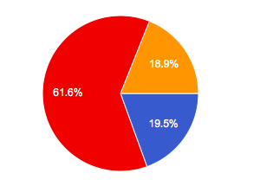
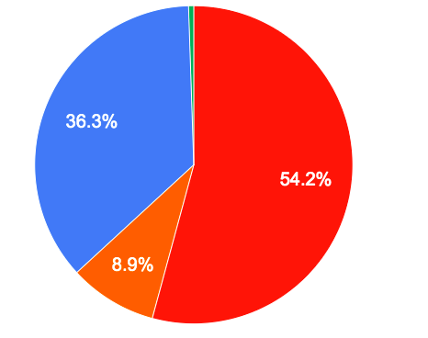
Have you ever wasted food or witnessed wastage of food?
Japan
Nepal
●frequently
●sometimes
●very few
●never

Slide 10
If yes, where? [Japan]

Slide 11
If yes, where? [Nepal]

Slide 12
Suggestion minimize food waste?
Raising awareness among people about food waste
To take only the amount of food you can finish.
Share with others if you order excess amount of food.
Using wasted food to create new menu.
Ask waiters small portion of rice
At the restaurant, people who leave foods have to pay
Giveaway to people in need (Nepal)
Feed street dogs (Nepal)
Appriciation toward foods

Slide 13
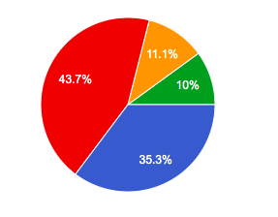
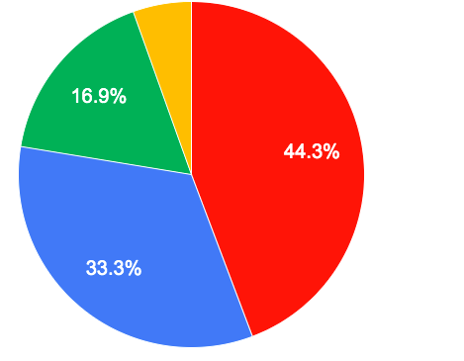
Have you ever done any of those you suggested in a daily life?
Japan
Nepal
●always
●occasionally
●a few times
●never

Slide 14
Conclusion
Many people are interested in this issue
Most of people are self aware of wasting food
Wasting food at home is highest rate in both countries
Many people are already taking action in their daily life
Nepalese suggested giveaway food to poor people and feed to street dogs
Japanese cannot connect the food waste issue to poverty

Slide 15
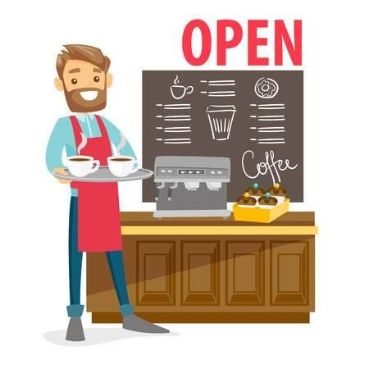
Positive implementation of restaurant owner
Customer can choose the portion of rice in lunch time
provide small portion of rice and who wants to eat more will pay 50 yen
He gives warnings to whom left food
Reuse the food
ex) making soup with leftovers from yesterday

Slide 16
Messages to from the owner
”Human beings live at the cost of many plants and animals, and this is inevitable. Please don’t forget to be humble and always be grateful to the food as well as your lives. ”
「人間は動物に限らず植物など沢山の命を犠牲にして、生きています。これは致し方ない事。だからこそ、謙虚な気持ちと感謝の心を忘れずに食材も無駄にせず、自分の命も大切に生き抜いていただきたい、生き抜いていきましょう。」

Slide 17
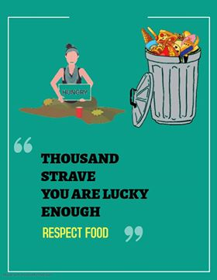
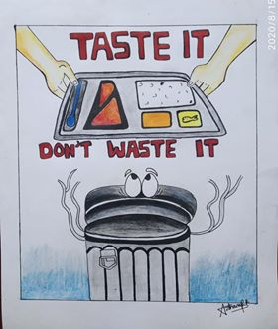
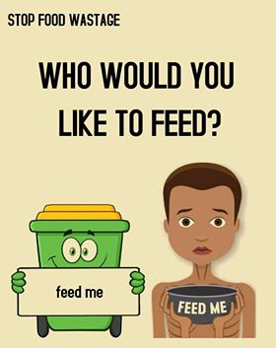
2. SNS advocacy
Making posters related to food wastage and posting them on SNS (Instagram, Facebook)

Slide 18
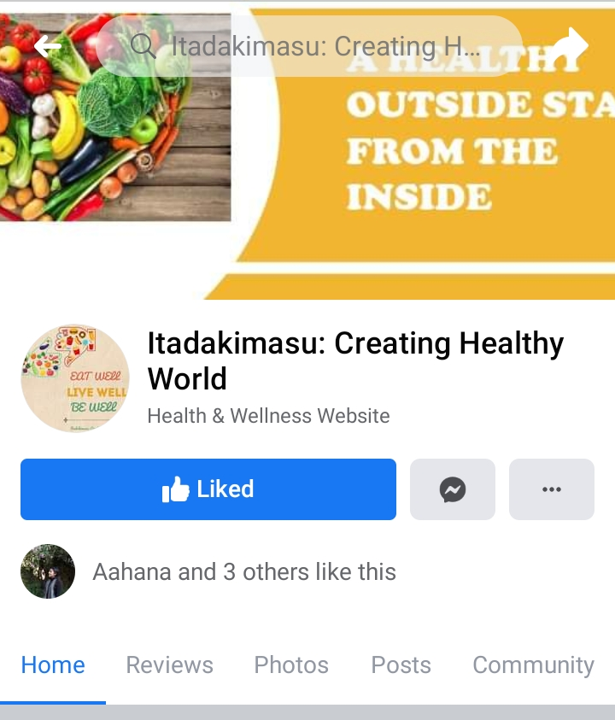
3. FACEBOOK PAGE
Make this implementation sustainably
"Itadakimasu" is the Japanese phrase which means thanking the food and people who have grown and cooked it
Main objective: to build a human chain to create a healthy world

Slide 19
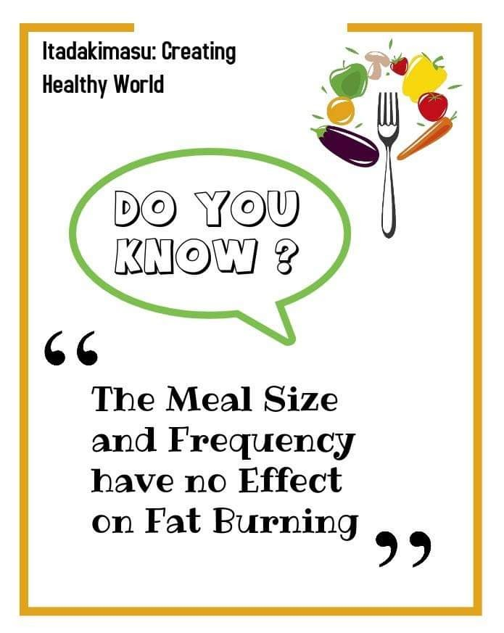
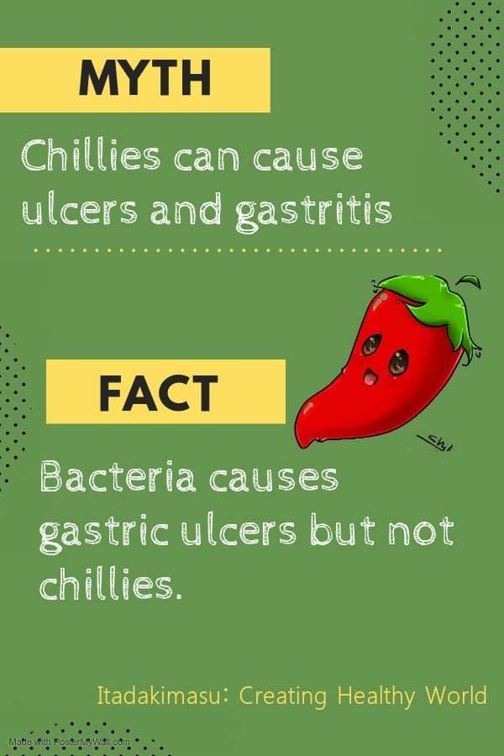

Slide 20
How to make Miso-soup?

Slide 21
”Possibilities of ONLINE Programs”
Though we had many limitations of not having met in real life, in different time zones and doing all the activities online, with dedication and team effort we made it possible.
Not only our team Didi Baini but also other teams had put their equal effort in their advocacy such a conducting interactive session with representative from LGBTQI community by gender team, online video competitions by nutrition team etc.

Slide 22
Thank you for your attention!

